Slide 1
PBCST304 Object Oriented Programming
Module 3 - More features of Java
(Part 3)
Prepared by
Renetha J.B.
Prepared by Renetha J.B.
1

Slide 2
Topics
More features of Java :
  Exception Handling:
    Checked Exceptions
    Unchecked Exceptions
    try Block and catch Clause
Prepared by Renetha J.B.
2

Slide 3
Exception Handling
An exception is an abnormal condition that occur in a code sequence at run time.
  Exception is a RUN TIME ERROR
A Java exception is an object that describes an exceptional (that is, error) condition that occurred in a piece of code.
When an exceptional condition arises,
  an object representing that exception is created and
  It is thrown in the method that caused the error.
    That method may choose to handle the exception itself, or pass it on.
    The exception is then caught and processed
Prepared by Renetha J.B.
3

Slide 4
Exception Handling(contd.)
Exceptions can be generated by
  the Java run-time system, or
  they can be manually generated by your code.
Exceptions thrown by Java are related to
  Fundamental errors that violate the rules of
    the Java language or
    the constraints of the Java execution environment.
4
Prepared by Renetha J.B.

Slide 5
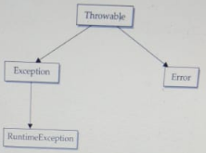
Exception Types
All exception types are subclasses of the built-in class Throwable.
Throwable has two subclasses that partition exceptions into two distinct branches.
  One branch is headed by Exception.
    This class is used for exceptional conditions that user programs should catch. Subclass of this helps to create custom exception types.
    RuntimeException(unchecked exception) is a subclass of Exception.
  The other branch is headed by Error
    This defines exceptions that are not to be caught under normal circumstances by our program.(unchecked)
    Exceptions of type Error are used by the Java run-time system to indicate errors.
    E.g. Stack overflow,Out of Memory error
5
Prepared by Renetha J.B.

Slide 6
EXCEPTION
CHECKED EXCEPTIONS
UNCHECKED EXCEPTIONS
Prepared by Renetha J.B.
6

Slide 7
Unchecked exception
Unchecked exception classes are defined inside java.lang package.
  The unchecked exceptions are subclasses of the standard type RuntimeException.
  In the Java language, these are called unchecked exceptions because the compiler does not check to see whether there is a method that handles or throws these exceptions.
  If the program has unchecked exception then it will compile without error but exception occurs when program runs.
E.g Exceptions under Error , ArrayIndexOutOfBoundException
7
Prepared by Renetha J.B.

Slide 8
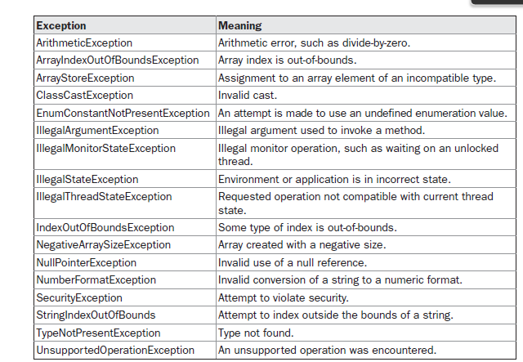
Unchecked exception(contd.)
The unchecked exceptions defined in java.lang are
8
Prepared by Renetha J.B.

Slide 9
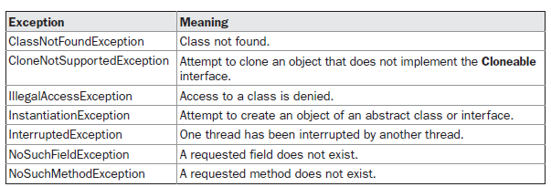
Checked exception
There are some exceptions that are defined by java.lang that must be included in a method’s throws list, if a method generates such exceptions and that method does not handle it itself. These are called checked exceptions
IOException
FileNotFoundException
SQLException
Prepared by Renetha J.B.
9

Slide 10
Checked exception(contd.)
Checked exceptions are the exceptions (in java.lang) that are checked at compile time.
  If some statement in a method throws a checked exception, then that method must
    either handle the exception or
    it must specify the exception using throws keyword.
Prepared by Renetha J.B.
10

Slide 11
Checked exceptions
Unchecked exceptions
Checked at compile time.(COMPILE TIME EXCEPTIONS)
Not sub class of RunTimeException
The method must either handle the exception using try-catch block or it must specify the exception using throws keyword.
Shows compile time error if checked exception is not handled.
E.g. ClassNotFoundException, IOException, SQLException. FileNotFoundexception
NOT checked at compile time.(RUN TIME EXCEPTINS)
Sub class of RunTimeException
It is NOT needed to handle or catch these exceptions
NO compile time error if exception is not handled. But shows run-time error.
Eg. ArithmeticException, ArrayIndexOutOfBoundsException,
NullPointerException
Prepared by Renetha J.B.
11

Slide 12
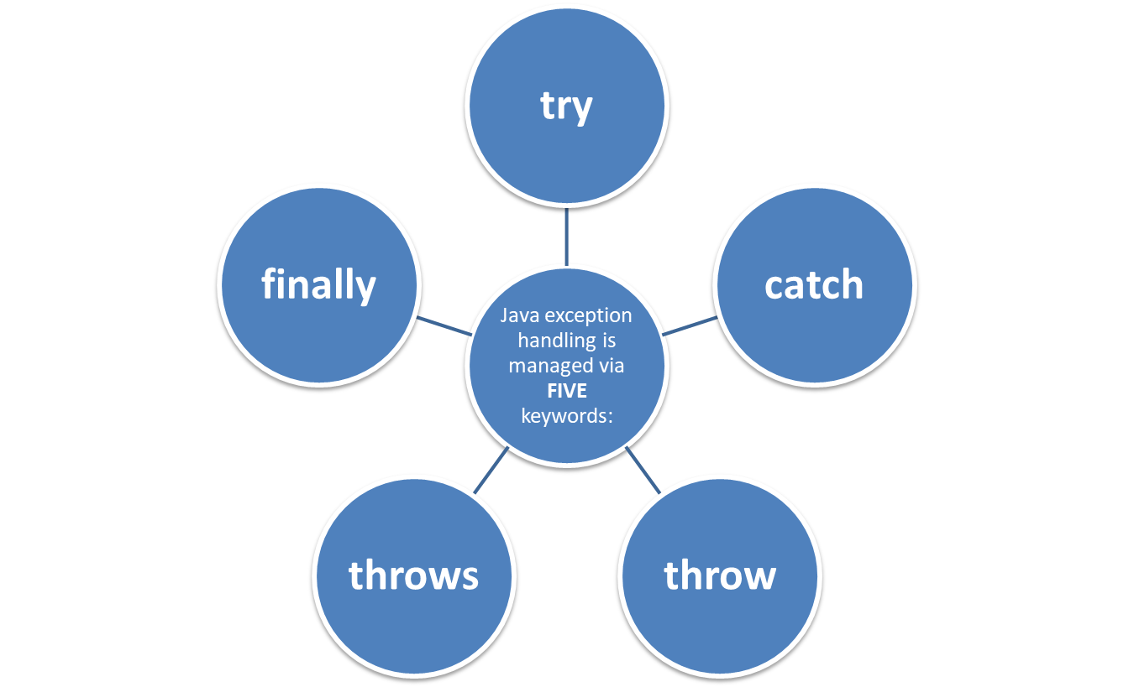
Exception handling fundamentals
Prepared by Renetha J.B.
12

Slide 13
Exception handling fundamentals(contd.)
Program statements that we want to check for exceptions are written within a try block.
  If an exception occurs within the try block, it is thrown.
  The code inside catch can catch this exception and handle it in some manner.
System-generated exceptions are automatically thrown by the Java run-time system.
To manually throw an exception, use the keyword throw.
Any exception that is thrown out of a method must be specified as such by a throws clause.
Any code that absolutely must be executed after a try block completes is put in a finally block.
Prepared by Renetha J.B.
13

Slide 14
try {
// block of code to monitor for errors
}
catch (ExceptionType1 exOb)
{
// exception handler for ExceptionType1
}
catch (ExceptionType2 exOb)
{
// exception handler for ExceptionType2
}
// ...
finally
{
// block of code to be executed after try block ends
}
Here, ExceptionType is the type of exception that has occurred.
Prepared by Renetha J.B.
14

Slide 15
Uncaught Exceptions
Consider the program
Lineno.1 class Ex{
Lineno.2 public static void main(String args[])
Lineno.3 { int d = 0;
Lineno.4 int a = 42 / d;
Lineno.5 }
Lineno.6 }
This small program causes a divide-by-zero error((42/0)
Java run time system constructs a new exception object and then throws this exception.
Th erogram stops by showing the following exception(run time erroe)
java.lang.ArithmeticException: / by zero at Ex.main(Ex.java:4)
Prepared by Renetha J.B.
15

Slide 16
java.lang.ArithmeticException: / by zero at Ex.main(Ex.java:4)
Here Ex is the class name , main is the method name,; Ex.java is the file name; and the exception is inline number 4.
These details are all included in the simple stack trace.
The type of exception thrown is a subclass of Exception called ArithmeticException (describes what type of error happened.)
Prepared by Renetha J.B.
16

Slide 17
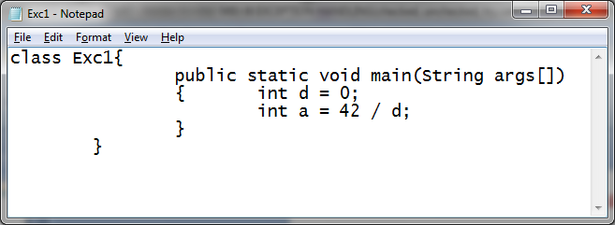
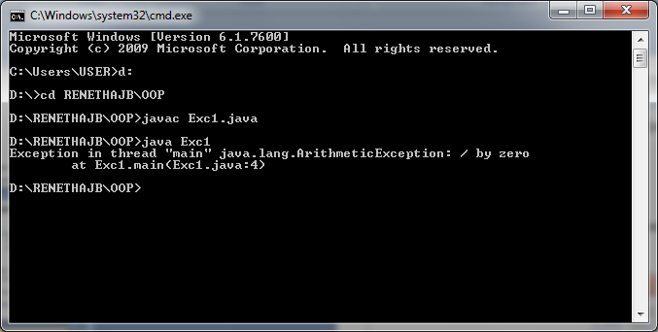
Prepared by Renetha J.B.
17

Slide 18
Lineno.1 class Exc1 {
Lineno.2 static void subroutine()
Lineno.3 { int d = 0;
Lineno.4 int a = 10 / d;
Lineno.5 }
Lineno.6 public static void main(String args[])
Lineno.7 { Exc1.subroutine();
Lineno.8 }
Lineno.9 }
java.lang.ArithmeticException: / by zero
  at Exc1.subroutine(Exc1.java:4)
  at Exc1.main(Exc1.java:7)
Prepared by Renetha J.B.
18

Slide 19
try Block and catch Clause
Benefits of exception handling
  First, it allows us to fix the error.
  Second, it prevents the program from automatically terminating.
To guard against and handle a run-time error, simply enclose the code that we want to monitor inside a try block.
Immediately after the try block, there is a catch clause that specifies the exception type that we wish to catch . The catch block can process that exception..
19
Prepared by Renetha J.B.

Slide 20
class Exc2{
public static void main(String args[])
{ try
{
int d = 0;
int a = 42 / d;
}
catch(ArithmeticException ae)
{
System.out.println("Division by Zero not allowed");
}
}
}
Prepared by Renetha J.B.
20

Slide 21
class Exc2{
public static void main(String args[])
{ try
{
int d = 0;
int a = 42 / d;
}
catch(ArithmeticException ae)
{
System.out.println("Division by Zero not allowed");
}
}
}
Prepared by Renetha J.B.
21

Slide 22
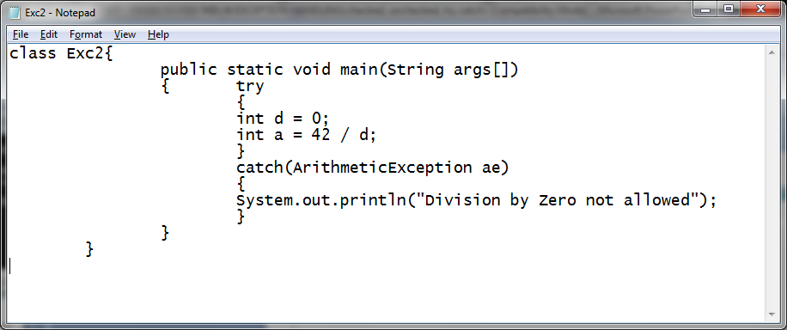
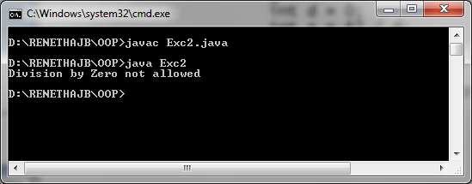
Prepared by Renetha J.B.
22

Slide 23
try-catch block to handle division by zero exception
class Ex {
public static void main(String args[]) {
int d, a;
try { // monitor a block of code.
  d = 0;
  a = 42 / d;
  System.out.println("This will not be printed.");
}
catch (ArithmeticException e) // catch divide-by-zero error
{
System.out.println("Division by zero.");
}
System.out.println("After catch statement.");
}
}
OUTPUT
Division by zero.
After catch statement.
Prepared by Renetha J.B.
23

Slide 24
Working of the program
  In this program the System.out.println("This will not be printed."); inside the try block is never executed because a = 42 / d;
  Once an exception is thrown, program control transfers out of the try block into the catch block.
    i.e. catch is not “called” but controls goes out to catch when exception occurs, so execution never “returns” to the try block from a catch.
    Thus, the line “This will not be printed.” is not displayed.
Prepared by Renetha J.B.
24

Slide 25
try-catch (contd.)
A try and its catch statement form a unit.
The scope of the catch clause is restricted to those statements specified by the immediately preceding try statement.
  Each catch block can catch exceptions in statements inside immediately preceding try block.
A catch statement cannot catch an exception thrown by another try statement (except in the case of nested try statements).
The statements that are protected by try must be surrounded by curly braces. (That is, they must be within a block.)
We cannot use try on a single statement
Prepared by Renetha J.B.
25

Slide 26
try-catch Example
import java.util.Random;
class HandleError {
public static void main(String args[]) {
int a=0, b=0, c=0;
Random r = new Random();
for(int i=0; i<32000; i++) {
try {
  b = r.nextInt();
  c = r.nextInt();
  a = 12345 / (b/c);
}
catch(ArithmeticException e)
{
  System.out.println("Division by zero.");
  a = 0; // set a to zero and continue
}
System.out.println("a: " + a);
} } }
Here b and c are random numbers .
If the value of b or c becomes zero then
a=12345./ (b/c) becomes
a=12345/0;
(Division by zero(ArithmeticException) will occur)
This statement is inside try block
So exception will be caught by catch and
prints message Division by zero.
and set the value of a to 0 and proceeds
NO RUNTIME ERROR!!
Prepared by Renetha J.B.
26

Slide 27
Displaying a Description of an Exception
We can display this description in a println( ) statement by simply passing the exception as an argument.
class Exc3{
public static void main(String args[])
{ try
{
int d = 0;
int a = 42 / d;
}
catch(ArithmeticException ae)
{
System.out.println("The exception occurred is "+ae);
}
}
}
Prepared by Renetha J.B.
27

Slide 28
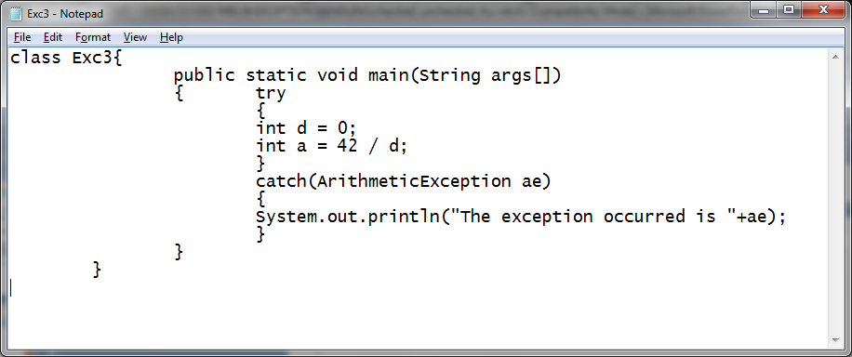
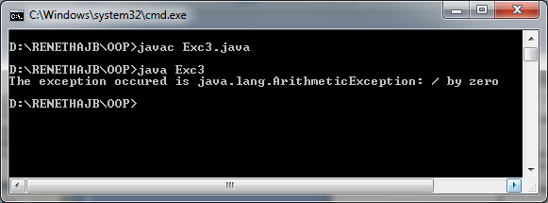
Prepared by Renetha J.B.
28

Slide 29
Reference
Herbert Schildt, Java: The Complete Reference, 8/e, Tata McGraw Hill, 2011.
Prepared by Renetha J.B.
29

